Slide 1
Factory

Slide 2
Intent

Slide 3
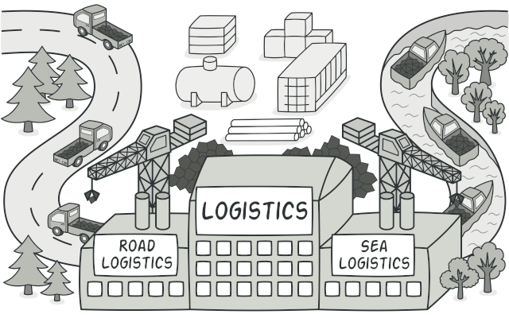
Intent
Factory Method is a creational design pattern that provides an interface for creating objects in a superclass, but allows subclasses to alter the type of objects that will be created.

Slide 4
Situation

Slide 5

Situation
APP

Slide 6
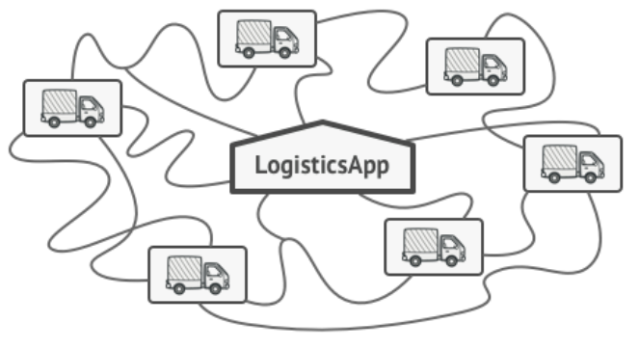
Situation
APP

Slide 7

Situation
APP
Popularity

Slide 8

Situation
APP
Popularity

Slide 9

Situation
APP
Popularity
Great News!!!

Slide 10

Situation

Slide 11
Solution

Slide 12
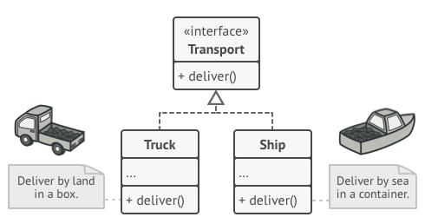
Solution
The Factory Method pattern suggests that you replace direct object construction calls with calls to a special factory method.

Slide 13
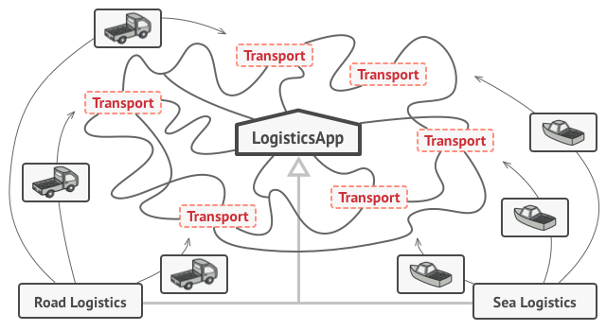
Solution
For example, both Truck and Ship classes should implement the Transport interface, which declares a method called deliver. Each class implements this method differently: trucks deliver cargo by land, ships deliver cargo by sea. The factory method in the RoadLogistics class returns truck objects, whereas the factory method in the SeaLogistics class returns ships.

Slide 14
Solution
The client code doesn’t see a difference between the actual products returned by various subclasses. The client treats all the products as abstract Transport.
The client knows that all transport objects are supposed to have the deliver method, but exactly how it works isn’t important to the client.

Slide 15
Structure

Slide 16
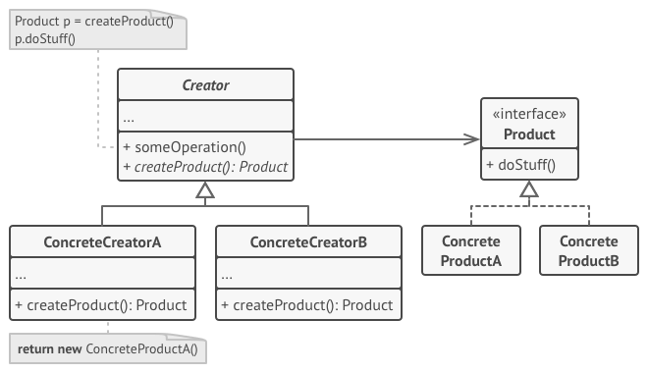
Structure

Slide 17
Structure
The Product declares the interface, which is common to all objects that can be produced by the creator and its subclasses.

Slide 18
Structure
Concrete Products are different implementations of the product interface.

Slide 19
Structure
The Creator class already has some core business logic related to products. The factory method helps to decouple this logic from the concrete product classes.

Slide 20
Structure
Concrete Creators override the base factory method so it returns a different type of product. The factory method doesn’t have to create new instances all the time. It can also return existing objects from a cache, an object pool, or another source.

Slide 21
Example

Slide 22
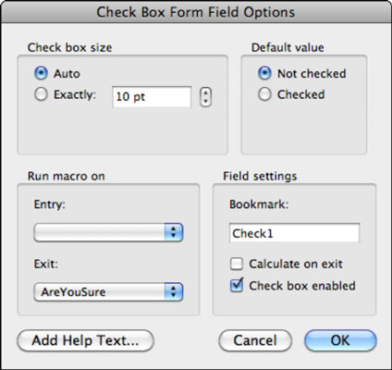
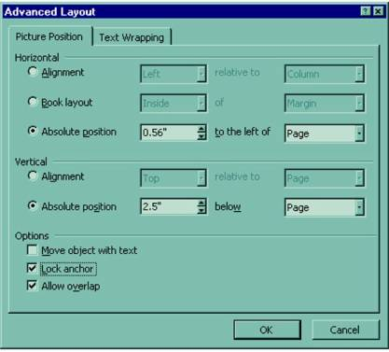
Example

Slide 23
Cod

Slide 24
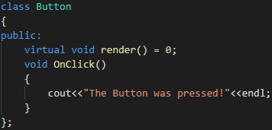
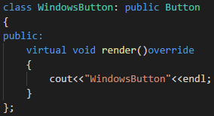
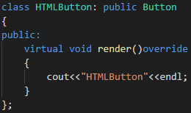
Cod

Slide 25
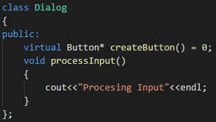
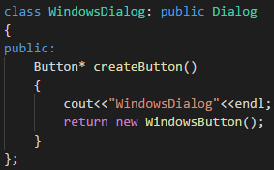
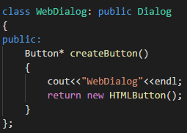
Cod

Slide 26
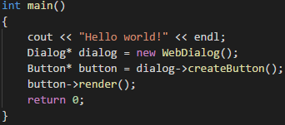

Slide 27
Aplicability

Slide 28
Aplicability
Use the Factory Method when you don’t know beforehand the exact types and dependencies of the objects your code should work with.
Use the Factory Method when you want to provide users of your library or framework with a way to extend its internal components..
Use the Factory Method when you want to save system resources by reusing existing objects instead of rebuilding them each time..

Slide 29
Abstract factory

Slide 30
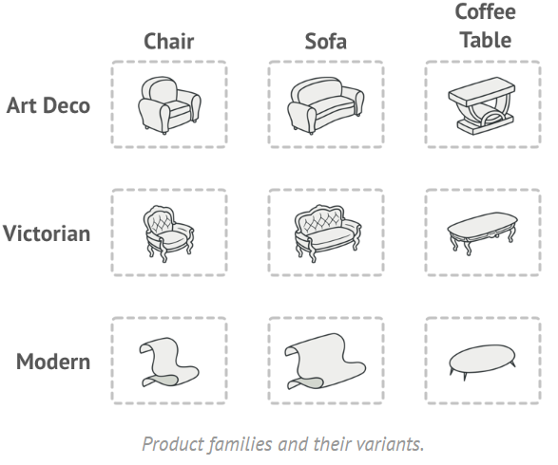
Abstract factory

Slide 31
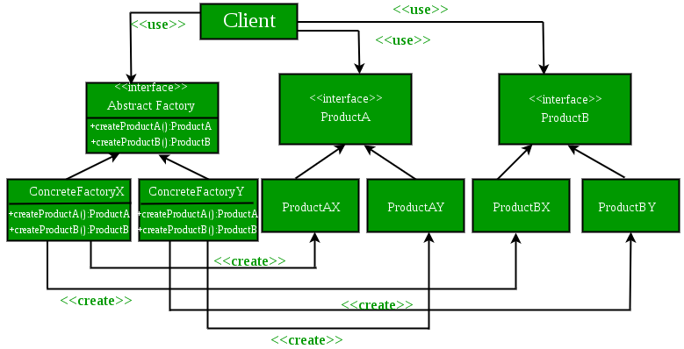
Abstract factory

Slide 32
Aplicability
Use the Abstract Factory when your code needs to work with various families of related products, but you don’t want it to depend on the concrete classes of those products—they might be unknown beforehand or you simply want to allow for future extensibility.

Slide 33
Abstract factory
Many designs start by using Factory Method (less complicated and more customizable via subclasses) and evolve toward Abstract Factory, Prototype, or Builder (more flexible, but more complicated).

Slide 34



Questions
Any questions?

Slide 35


Thanks!
Thank you!

